Slide 1
Topic: virtual contact list using python
TEAM MEMBERS:
NITHIN KUMAR S(1JB22CS097)
PAVAN KUMAR KS(1JB22CS102)
PRASHANTH KT (1JB22CS110)
PREETHU G (1JB22CS111)
DEPARTMENT OF CSE

Slide 2
Table of contents
Introduction
Feature
Benefits
Output
conclusion

Slide 3
5
Virtual Contact List Using Python
4
This mini project is a virtual contact list application built using Python. It allows users to add, edit, delete, and search for contacts in their virtual contact list. The application is simple to use and can be used on any device that has Python installed.
3
2
1

Slide 4
5
Features:
4
Add, edit, delete, and view for contacts
Store contact information such as name, phone number.
Organize contacts into groups
Exit from the contacts
3
2

Slide 5
5
Benefits:
4
Keep all of your contacts in one place
Easily access your contacts from any device
Organize your contacts into groups for easy management
Easily export and import contacts
3
2
This mini project is a great way to learn about Python programming and to create a useful application for yourself. The code is well-written and easy to understand, making it a good starting point for beginners.

Slide 6
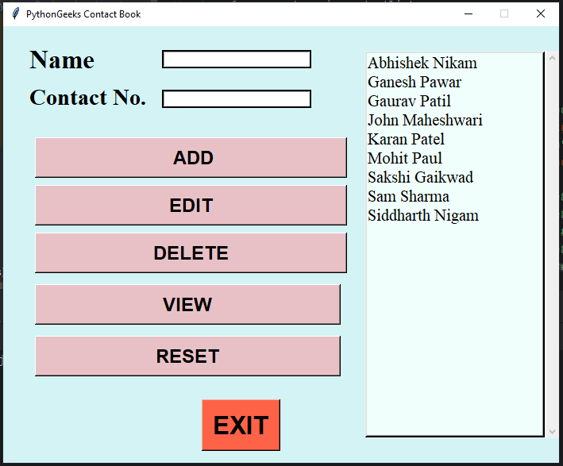
4
5
This is the output:
4
3
2

Slide 7
5
Conclusion:
4
The virtual contact list application is a simple and useful application that can be used on any device that has Python installed. It is a great way to learn about Python programming and to create a useful application for yourself.
3
2

